Slide 1
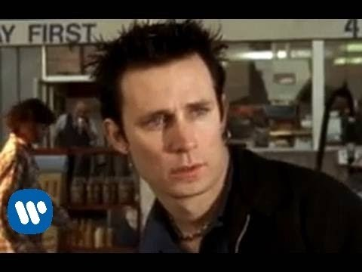
2025 Senior Info
& Cash Campaign
Graduation Countdown
Notes:
Student notes on computer under 2019 senior info and cash campaign

Slide 2
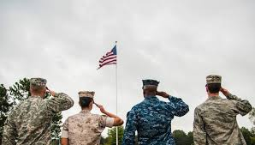
2nd Semester
Skilled Trades & Military
Military
Research Programs/Jobs
ASVAB
Meet w/ Recruiter
Skilled Trades/Careers
Research Skilled Trades Programs at community colleges, through unions and other trade schools.
Research when you can apply and/or how to apply.
Community College Programs
MI Construction Careers
Northwest Ohio Construction Education Center
Late April– Monroe County Career Expo
MCCC Lifelong Learning & Michigan Achievement Scholarship

Slide 3
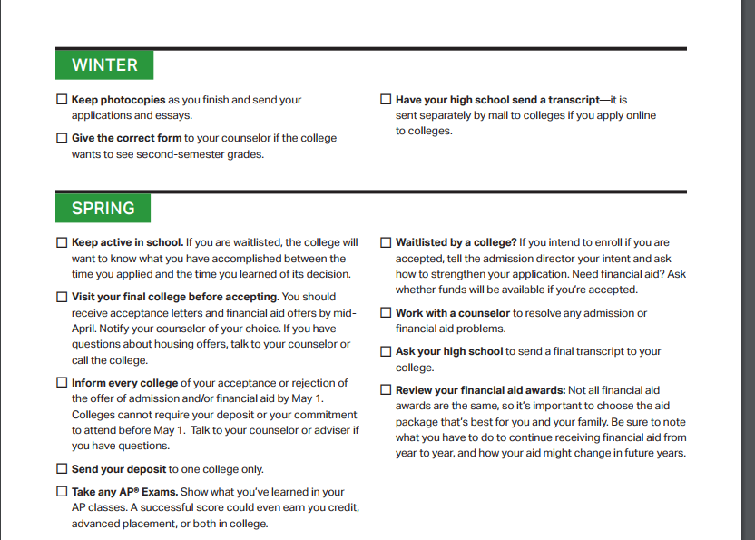
2nd Semester College Checklist
Check your college accounts weekly!!!

Slide 4
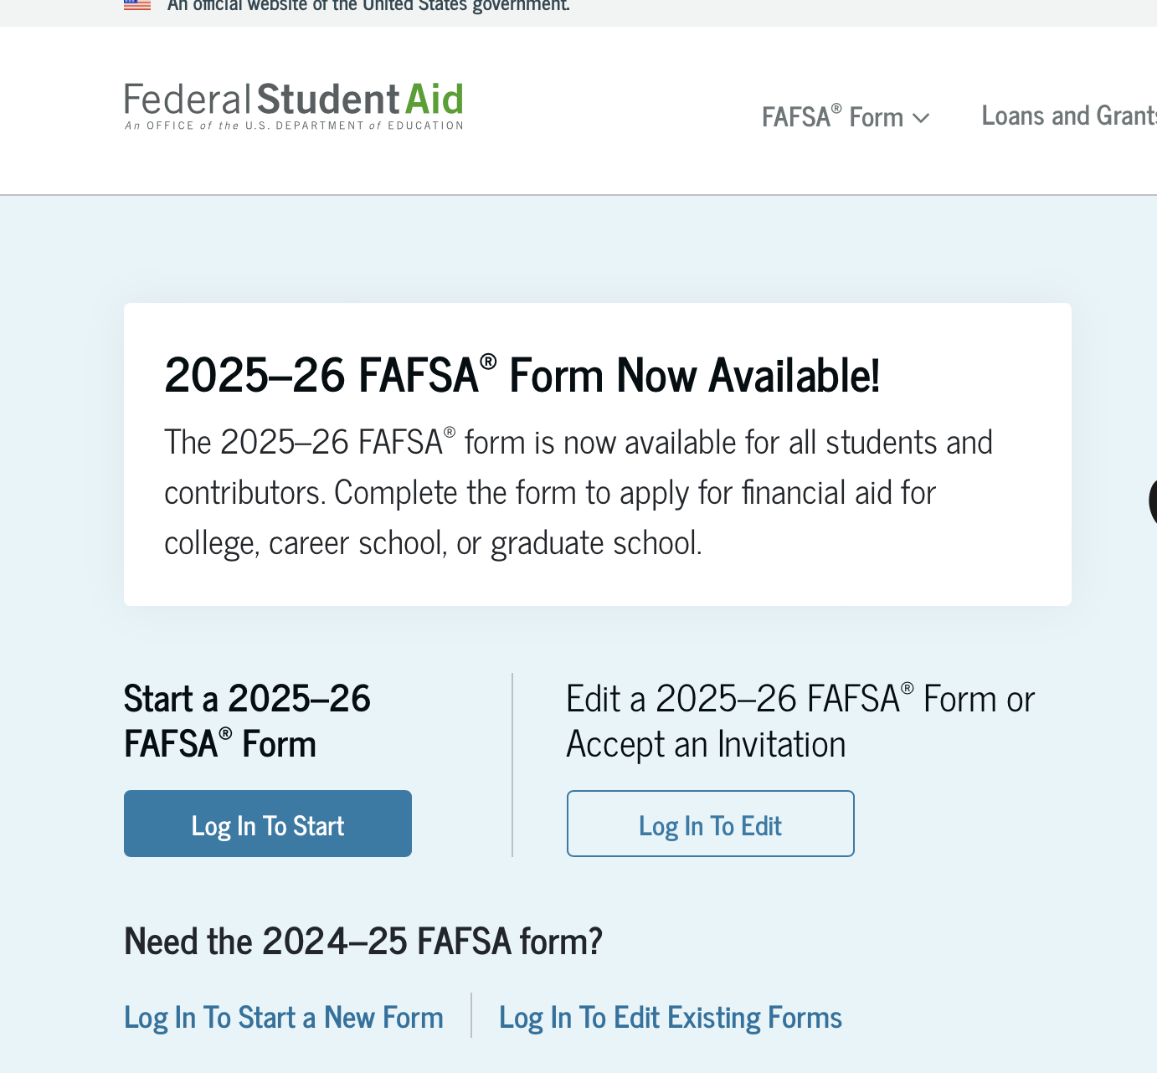
FAFSA
What does FAFSA stand for?
Why would someone complete a FAFSA?
College Section-MI School
FAFSA-March 1st Deadline (preferred by most colleges & more access to money)
FAFSA Preferred Deadlines Depends on the university and/or scholarship

Slide 5
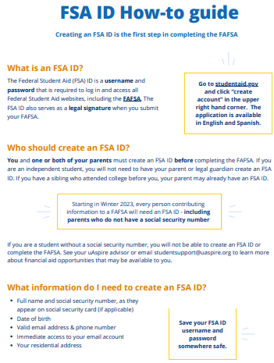
FSA ID
FSA ID Tips and Tricks
It might take a few days to process your FSA ID
Complete all two-way verification options
Consent to Direct Data Exchange (DDX)

Slide 6
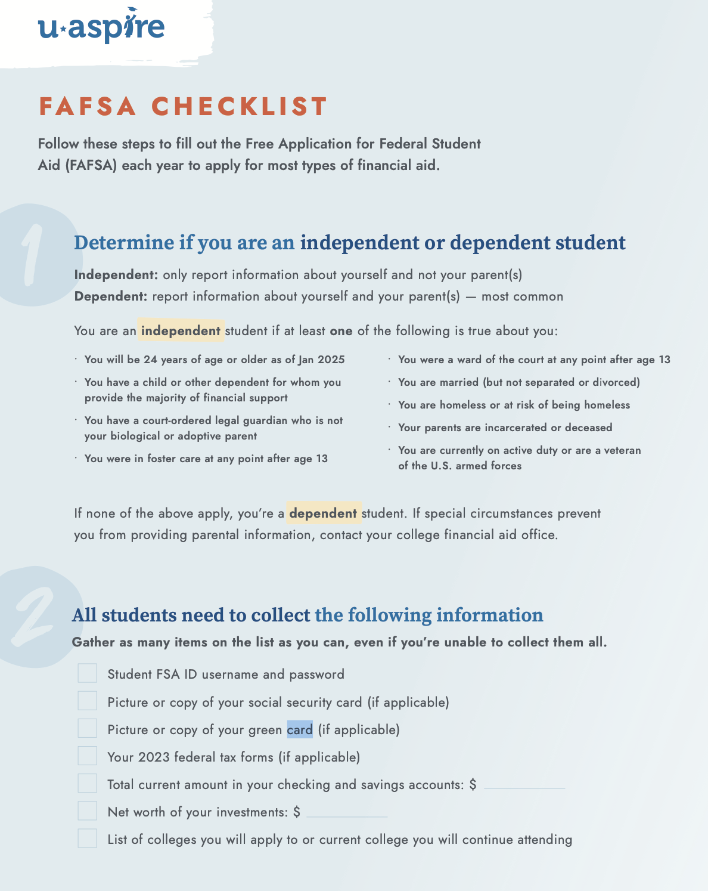
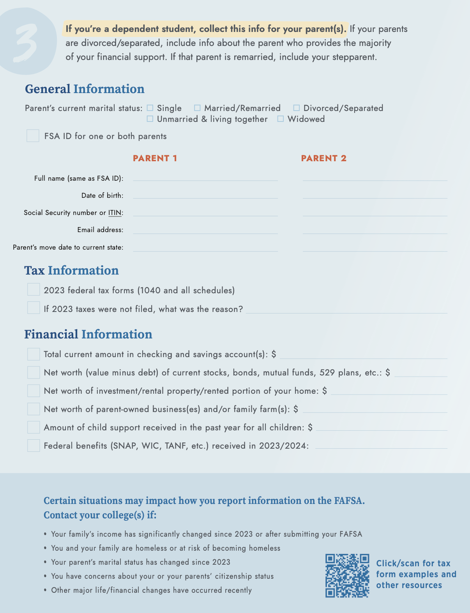
FAFSA Checklist

Slide 7
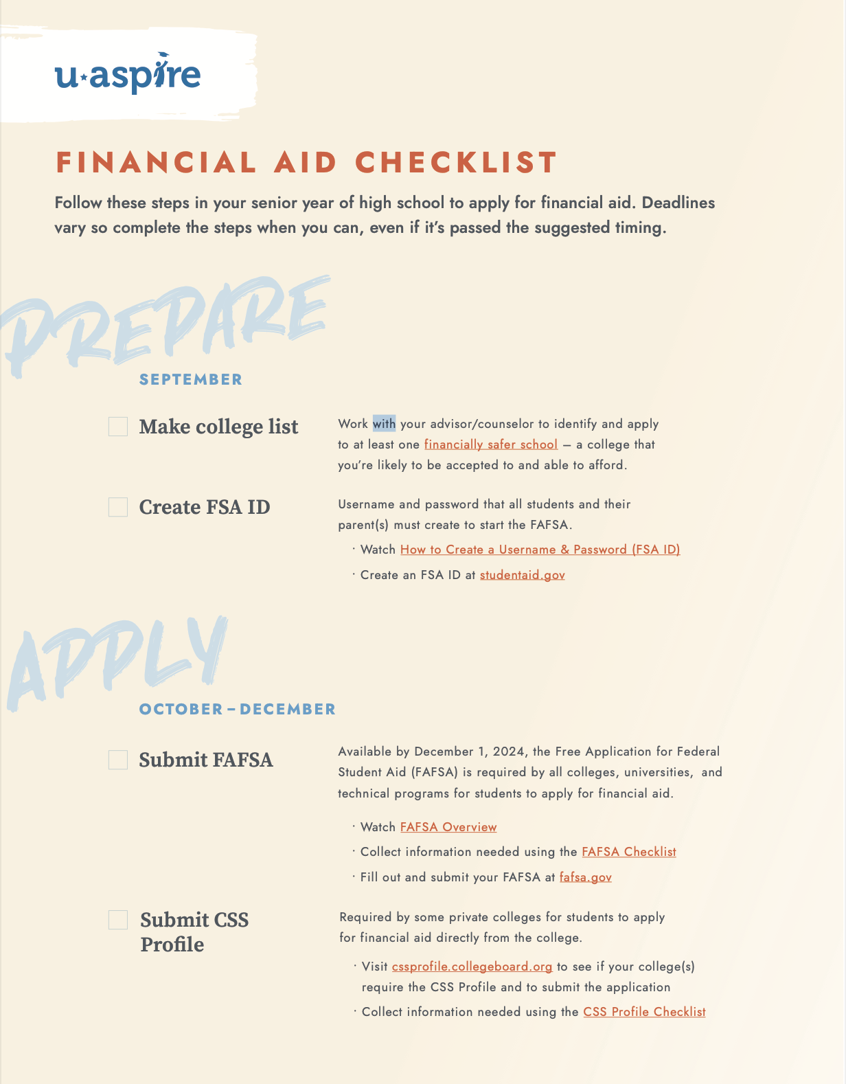
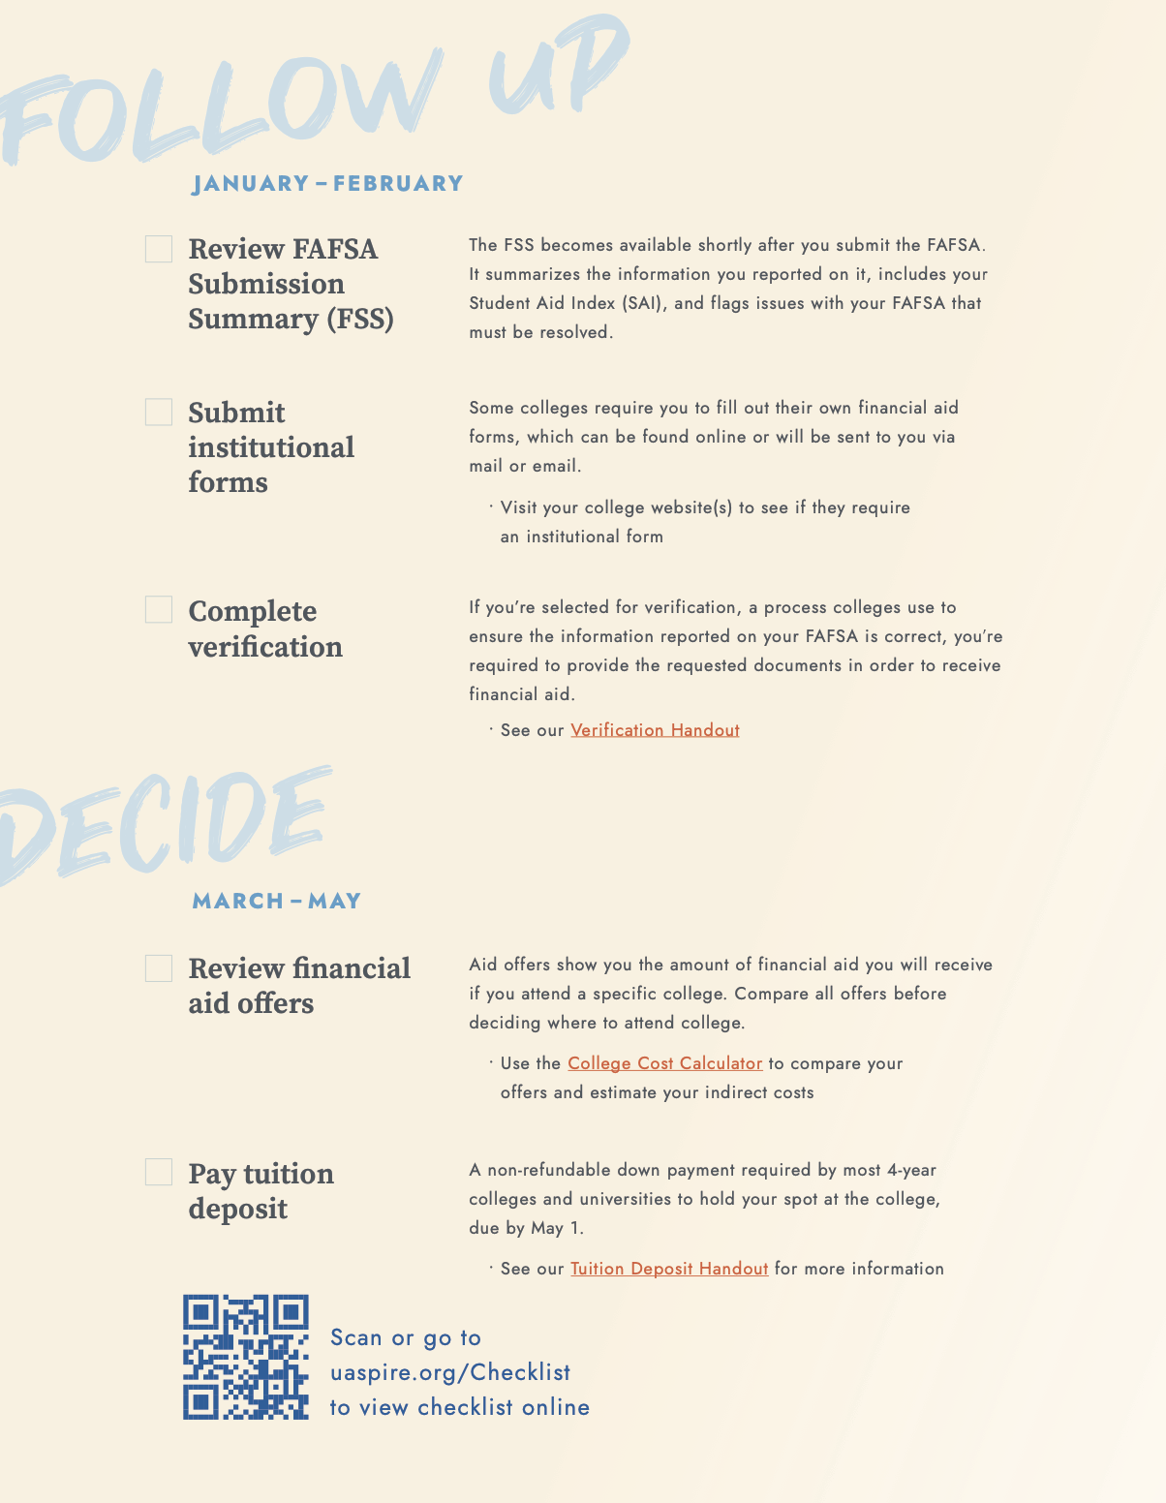
Financial Aid Checklist

Slide 8
FAFSA Terms
Contributor: any individual required to provide consent and approval for federal tax information
Student Aid Index (SAI): replaces the Expected Family Contribution (EFC) as a formal evaluation of a student’s approximate financial resources to contribute toward their postsecondary education for a specific award year
FAFSA Submission Summary: replaces the Student Aid Report (SAR) as the student’s output document providing a summary of data input on the FAFSA form.
Verification is a routine process colleges use to ensure the information reported on your financial aid applications, such as the FAFSA, is accurate. It doesn't mean you did anything wrong! The process involves submitting forms and documents to the financial aid office.

Slide 9
Financial Aid Review of Terms
Scholarship- Forms of aid that help students pay for their college education. Scholarships do not have to repaid.
Grant-Gift Aid for college students. It does not have to be repaid.
Work Study- Work study is a financial aid program funded at the federal or state level that helps college students in financial need to get part-time jobs alongside their studies. The income earned from work-study can help with tuition, living expenses and other education-related costs
Loans-Form of aid for college students that have to be repaid.

Slide 10
Notes:
Use this instead of the next slide next year. Print a copy for the students.

Slide 15
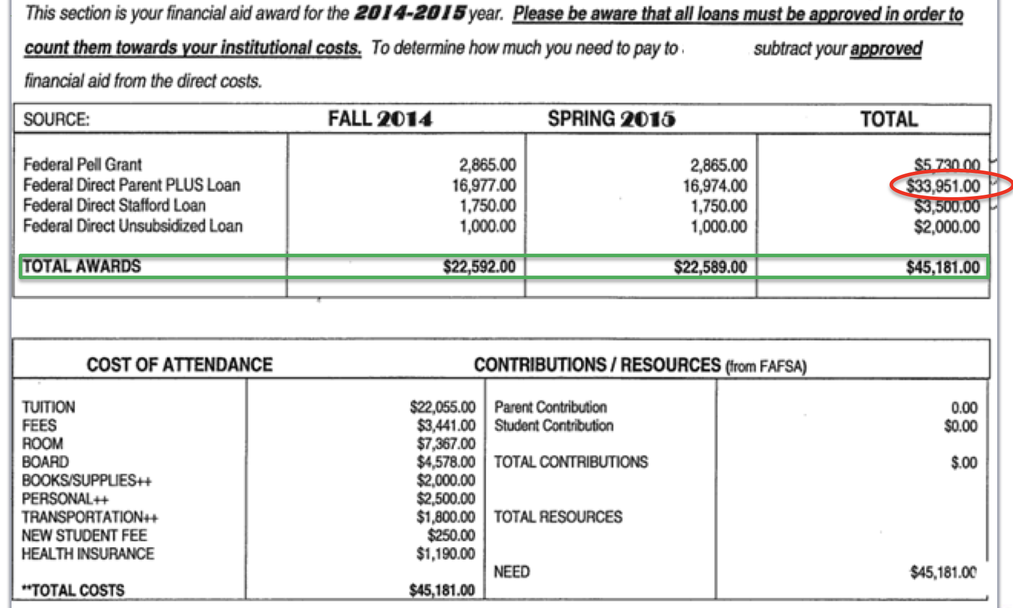
Electronic Award Letter
Notes:
Have students label the direct cost and indirect cost
Have students label the direct costs and add up the total (Food, Housing, Tuition) Total of Direct cost per semester $7,986 Per Year $15,972
What is the total fin aid the student has been offered? $15,521 What will the student owe in direct cost for the year $451 per semester $225.5
What can the student do to cover the $3792 Indirect cost?

Slide 16
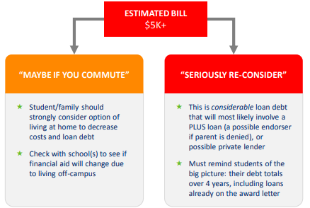

Slide 17
Download Award Letter Analyzer
-Ida Public Schools
-HS Guidance Department
-Paying for College
-Award Letter Analyzer
IHS Guidance Page

Slide 18
FEDERAL LOANS
Direct Subsidized Loans are for students with demonstrated financial need. There is no interest charged while an undergraduate student is in school at least half-time, during deferment, or during grace .
Direct Unsubsidized Loans are federal student loans that aren’t based on financial need. Your school determines the amount you can borrow based on the cost of attendance and other financial aid you receive. Interest is charged during all periods and will be capitalized. This increases your total federal loan cost.
Direct PLUS Loans are unsubsidized credit-based federal loans for parents of dependent students and graduate/professional students. PLUS loans can help pay for education expenses up to the cost of attendance. These are paid for immediately. A lot of colleges will put it on the award letter.

Slide 19
LIMITS ON FEDERAL LOANS
These amounts can increase as you are successful throughout college.

Slide 20
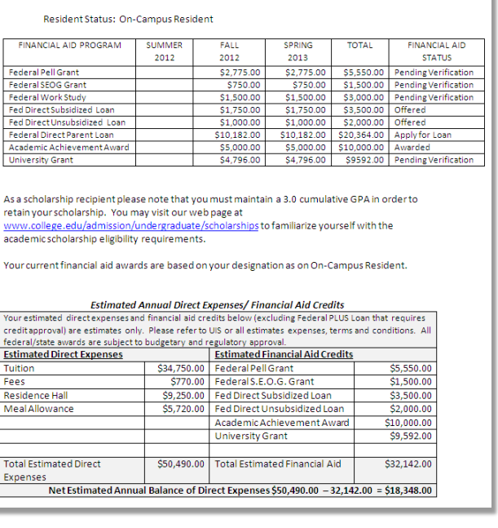
Notes:
What is this student offered in gift aid (grants scholarships)? 2775+750+4796 =8321
How much in loans? 1750+1000+10182=12932 Work Study-1500 Scholarship-5000
(Note the grants are pending verification)
Review the loans
Student owes over $18,000 that does not include work study or the parent plus loan? Why not?

Slide 21
SCHOLARSHIPS
Scholarships will start to come out now through early May.
Make sure to build time into your schedule to complete required items for scholarships such as transcript and letter of recommendation.
Local Scholarships
MCCC Endowment/Annual Scholarship-March 1st
MCCC Presidential & Music Scholarship

Slide 22
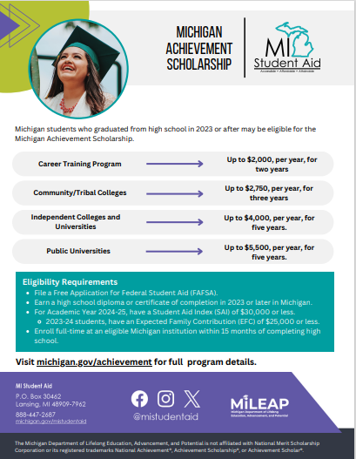
Michigan Achievement Scholarship & MI paying for College
Michigan Achievement Scholarship
To do:
Complete FAFSA
Create MiSSG Portal Account
Eligibility SAI of 30,000 or less
This scholarship may appear on some award letters. Make sure to contact financial aid to ask if you qualify
MI Paying For College Scholarship
MISSG Student & Family and Portal

Slide 23
Cash Campaign
Goal: Students would shift their focus to complete the FAFSA and scholarships
Any student that has completed their FAFSA by February 11th can PRINT OFF the confirmation FAFSA completion page to receive a FREE Winterfest ticket!! Please turn in your printed confirmation into the office by 2/11 @ 3:00.
**NO LATE CONFIRMATIONS WILL BE ACCEPTED!**

Slide 24
FAFSA Senior Sem/Fin Lit Competition
The class with the highest percentage of FAFSA completed by March 14th wins a pizza party or breakfast.
Forward Mrs. Ryan your confirmation page of completion (ryan@idaschools.org)

Slide 25
D&P Scholarships
4 $500 Scholarships
-2 $500 scholarships will be awarded to 1 student who completed their FAFSA in the class who wins the FAFSA Class Competition.
-2 $500 scholarships will be selected from the raffle.
3 tickets for anyone who has already completed their FAFSA or does by Feb 28th
1 ticket for FAFSA completion before March 14th
1 ticket for completion of three scholarships (between Jan 1st-March 14th)
Proof must be emailed to Mrs. Ryan or provided to the office by 4:00 on March 14th.

Slide 26
Upcoming Important Dates
February-March 15th FAFSA/Scholarship Raffle
February 18 Sen Sem/ Fin Aid Scholarship/FAFSA Workshop
March 14 Cash Campaign Class Competition Ends
Mid March MCCC PN & RN Nursing Program Info Meeting
Early-Mid March Senior Conferences
TBD Career Expo*
May 23rd Decision Day
May 30th Graduation Practice
June 1 GRADUATION!!!
* Sign-up Required Cash Campaign Survey

