Slide 1
Ida School Improvement Update
September 29, 2016

Slide 2
MDE Fall School Improvement Conference
November 21- Keynote Dr. Eric Jensen
This powerful day explores both the science behind engaging students living in poverty and the specific classroom strategies to reach students living in poverty.
November 22- Dr. Jensen
Dr. Jensen will dig deeper by looking at “Tools of Engagement.” Participants will get a copy of Eric Jensen’s popular book Tools for Engagement.

Slide 3
Continuous Fall To-Do List
Surveys (staff, students, parents)
Comprehensive Needs Analysis
Adjust SIP Goals based on CNA
Title 1
Presentation
Handout

Slide 4
Types of Goals
Academic
Organizational
Address student achievement in content areas
Address non-academic systemic practices, processes, and procedures

Slide 5
MDE Guidance on Goals Academic
Schools are encouraged to write 3-5 goals
Schools are required to write a goal in any content area for which they do not meet the individual school and district proficiency targets.
Title 1 schools must address any content area that is identified in the comprehensive needs assessment

Slide 6
MDE Guidance on Goals Organizational
Organizational goals are optional
Organizational goals may focus on structures and initiatives that support the attainment of academic goals
Examples: culture/climate, student behavior/character education, parent involvement, attendance, etc…

Slide 7
Shifting Mindset

Slide 8
What might this new process look like?

Slide 9
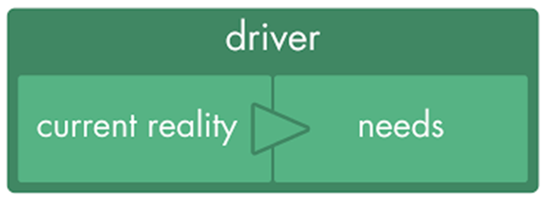
Gather & Study Phase 2016-17
Comprehensive Needs Assessment
Achievement (state & local)
Process (SSR)
Perception (surveys)
Demographic (students & staff)

Slide 10
Develop an Improvement Plan Spring/Summer 2017
Based on CNA
Research based strategies selected must be aligned to needs identified in CNA
Gold Standard
Implementation Guides

Slide 11
Implement Plan Fall 2017
Monitor and Adjust plan Spring 2018-2022
Performance Management (progress monitoring)
Fidelity of Implementation
(adults)
Year 1
Achievement
(students)
Years 2-3
Program Evaluation
Tool

Slide 12
Transitioning Timeline
CNA- December
Academic & Non-academic indicators
GAP statements for ALL Students to targets & Demographic Groups to ALL students
Strategy Selection Process- April
Research multiple options, present options for staff input, select
Develop Implementation Plan
Define Critical Components of the RB strategy (Gold Standard)
3 Year School Improvement Plan- May
Year 1 Implementation Plan & Eval of Implementation (PET 1-3)
Years 2-3 Progress Monitoring Plan (PET 4-5)
Year 3 Final Program Evaluation (Institutionalize?)

Slide 13
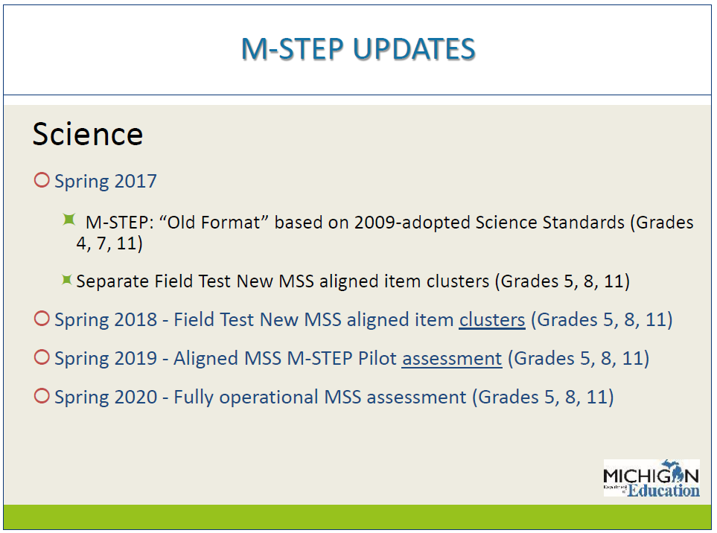

Slide 14
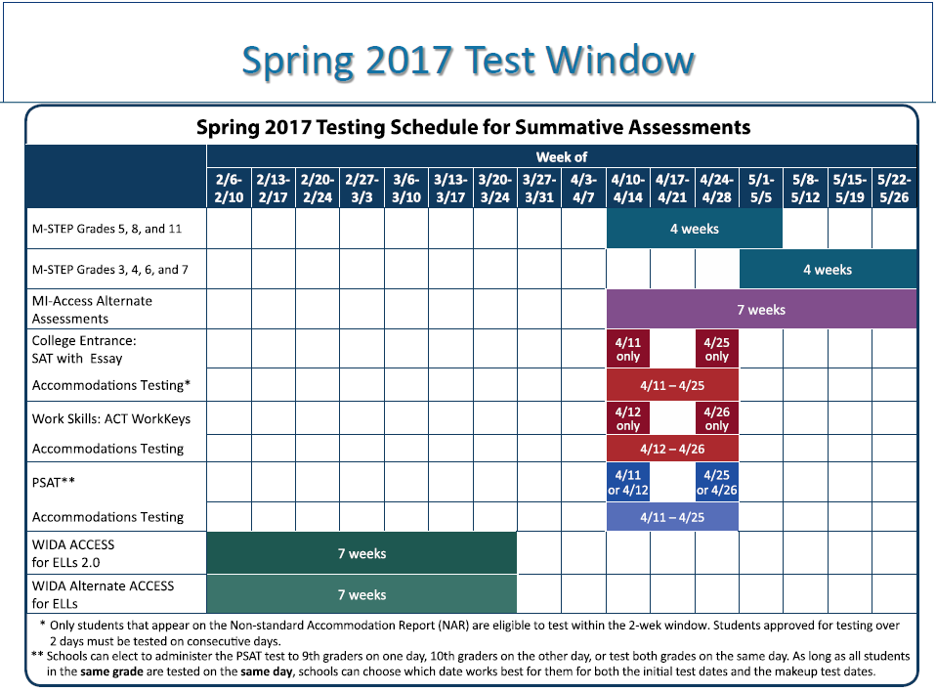

Slide 17
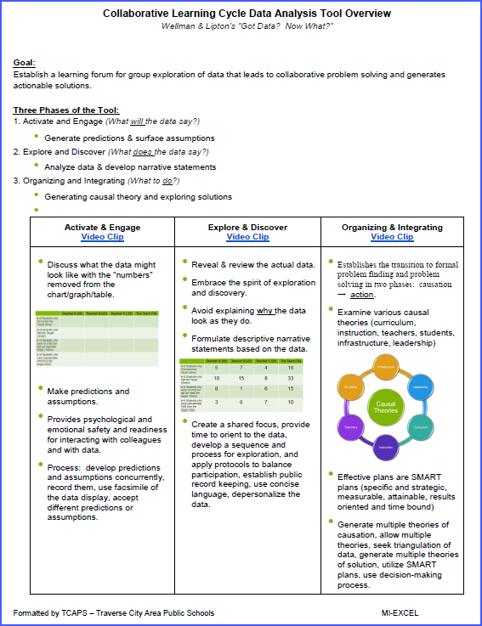
MI-EXCEL Data Conversations Protocol

Slide 18
Contact Information:
Chris Todd
Education Consultant
242-5799 x1328
Christine.todd@monroeisd.us

